Slide 1
ADAPTIVE MAIL – FLEXIBLE EMAIL CLIENT APP

Slide 2
DESCRIPTION
Adaptive Mail app is a sample project that demonstrates how to use the Android Compose UI toolkit to build a conversational UI. The app simulates a messaging interface, allowing the user to send and receive messages, and view a history of previous messages. It showcases some of the key features of the Compose UI toolkit, data management, and user interactions

Slide 3
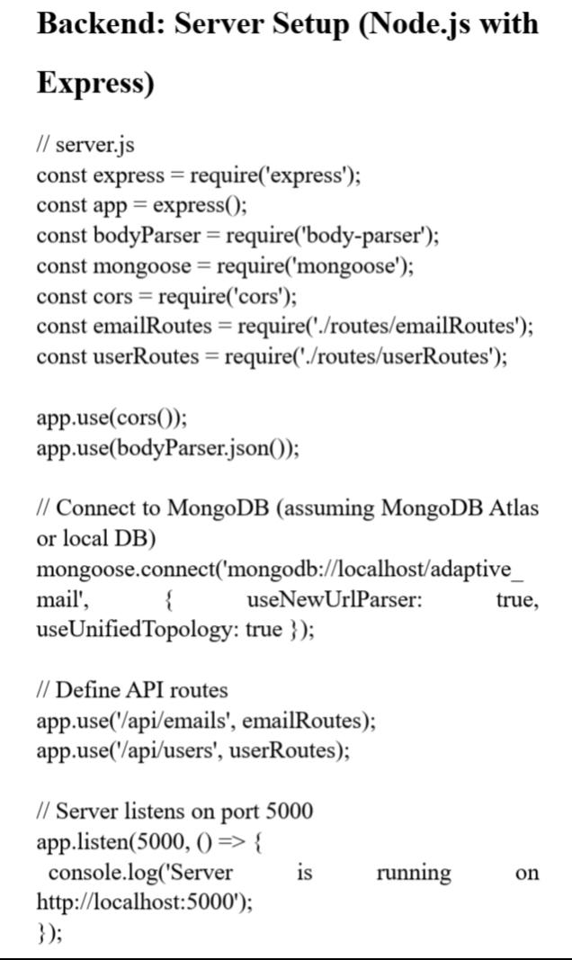
MAIN ACTIVITY IN JAVA

Slide 4
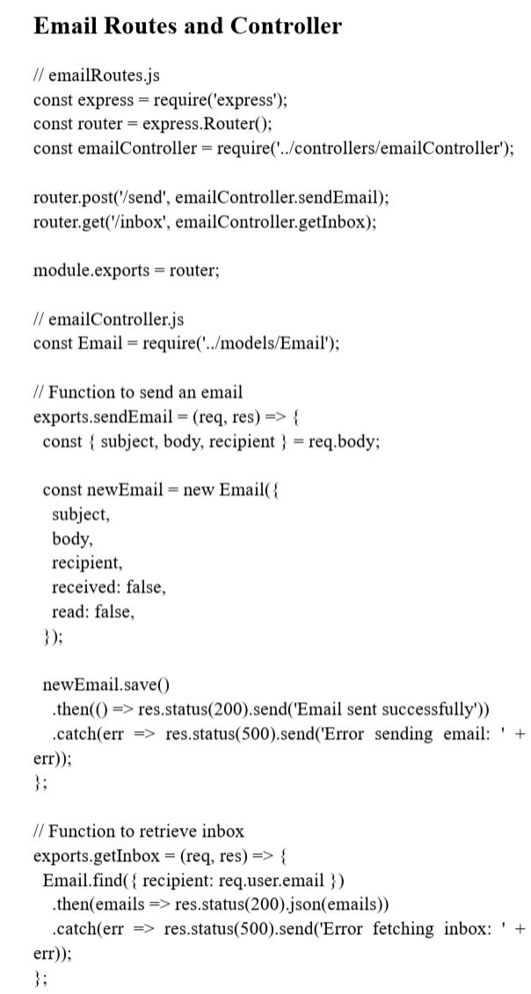

Slide 5
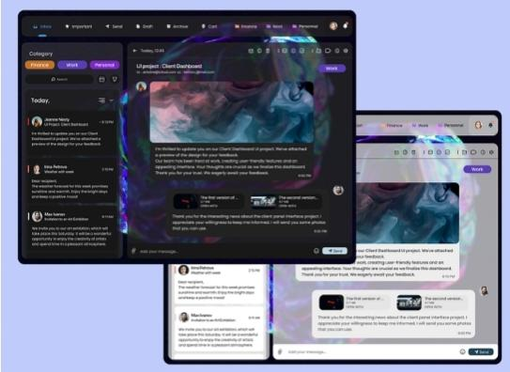
OUTPUT

